Slide 1
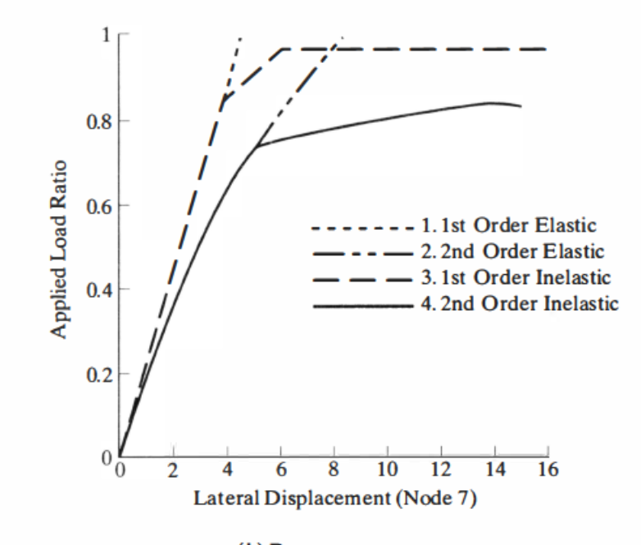
1st-Order Inelastic MASTAN Extension
Cesar Marco and David Tse
Notes:
DT

Slide 2
Matlab Coding Journey for Static Analyses
CEE 280: 3D 1st Order Elastic Analysis
Ke
3D formulation
Fixed end forces
CEE 282: 2D 2nd Order Elastic Analysis
Ke and Kg
Single-step no iterations
Natural Deformation Element Force Recovery
CEE 282: 2D 1st Order Inelastic Analysis
Ke, Kg and Kp
Return Methods
Notes:
DT

Slide 3
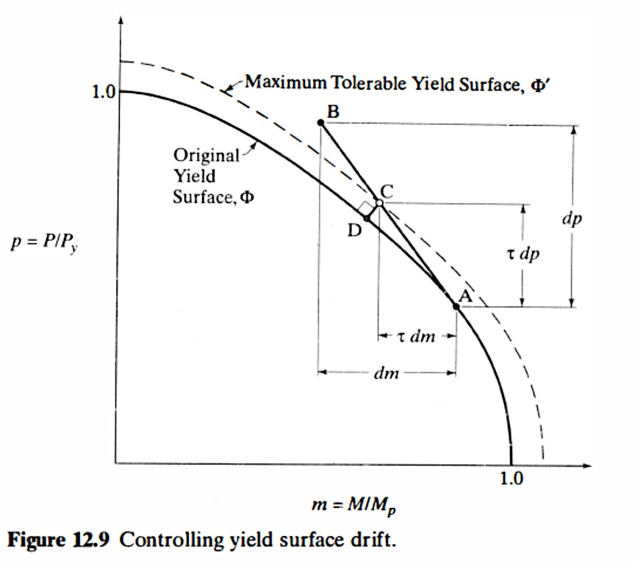
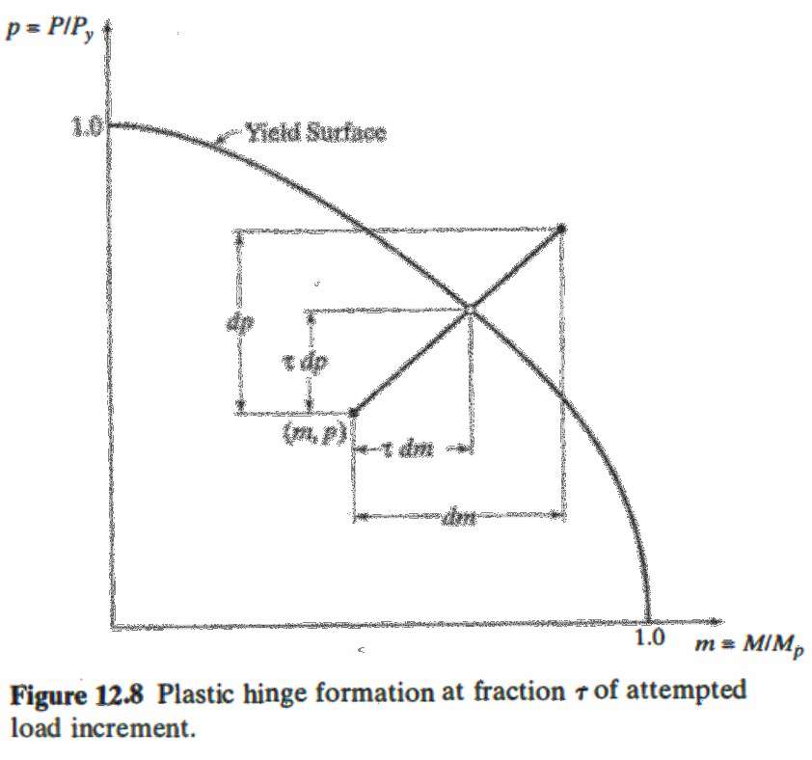
Return Method: Regula Falsi Algorithm
Case 1: Incremental step breaches the Yield Surface
Case 2: Incremental step breaches a maximum tolerable yield surface
Source: MGZ
Notes:
DT

Slide 4
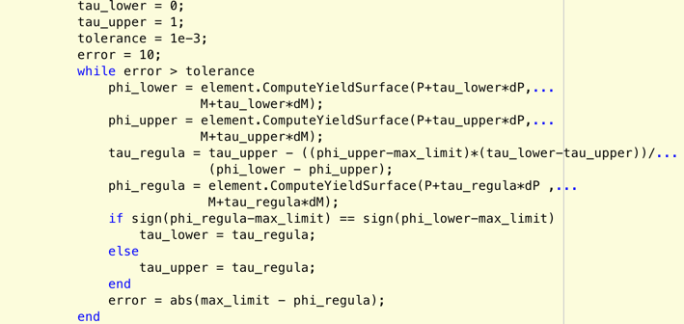
Regula Falsi Algorithm
Set the initial upper and lower limit values for tau
While loop to reduce error:
Calculate the upper and lower bound of YS
Calculate an interpolated value for the YS and tau to return step to a specified value
Update the upper or lower limit of tau by comparing their signs with the interpolated tau
Calculate Error, iterate
Use RF algorithm for each element
→ Determine tau_regula for each element →
Only use the minimum value so ONLY 1 hinge yields at a time
Notes:
DT

Slide 5
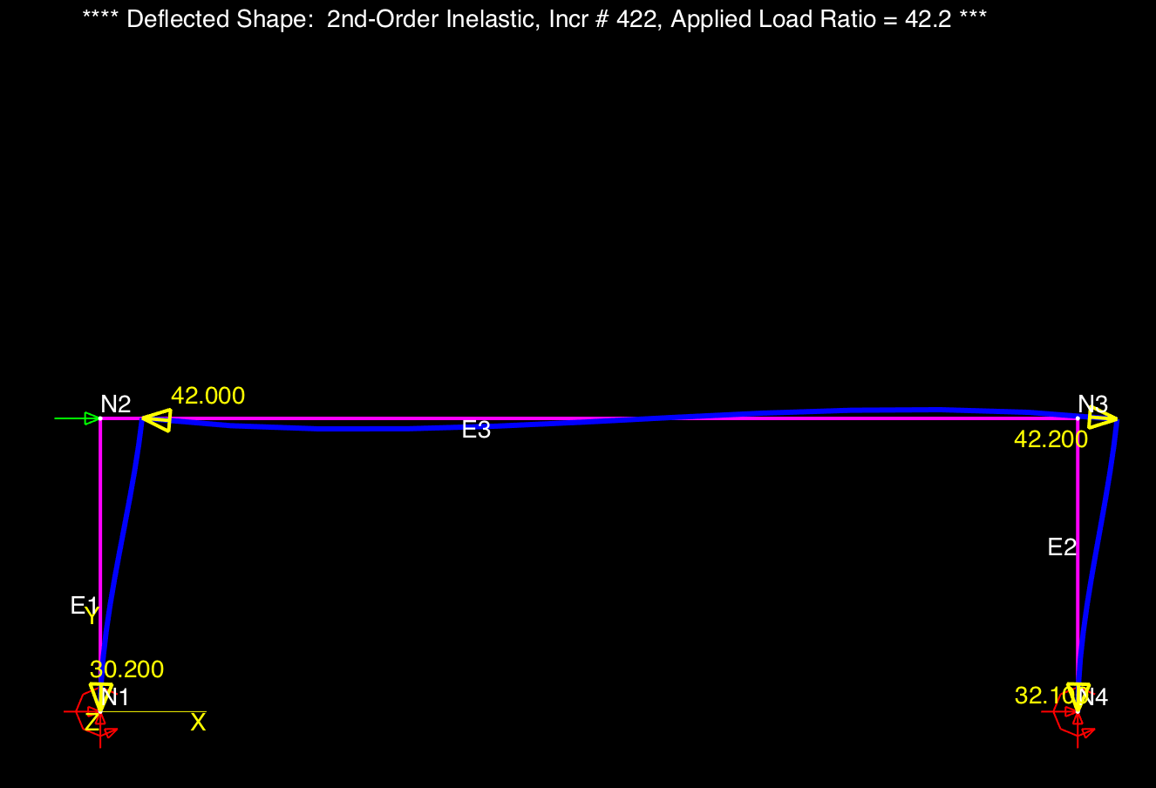
Testing Code with Fixed Base Frame
Geometry + Material
Fy = 50 ksi
W30x99
10 kip lateral load on top-left joint
1st Order Inelastic Inputs:
Solution Algorithm: Single Step
Increment Size = 0.8
Max APR = 42
10 kips
12 ft
40 ft
Notes:
DT

Slide 6
Applied Load Ratios to Hinge
Hinge # | Location | MASTAN’s APR | Our Code’s APR | Difference
 | Column support | 30.284 | 30.2831 | -0.0030%
 | Column support | 32.233 | 31.7659 | -1.4491%
 | Beam end (left) | 42.0 | 41.1569 | -2.0074%
 | Beam end (right) | 42.2 | ? | N/A
1
3
4
2
3
4
1
2

Slide 7
Displacements
Joint | Mastan’s Results |  |  | Our Code |  |  | % Difference
 | x-disp. | y-disp. | z-rot. | x-disp. | y-disp. | z-rot. | x-disp. | y-disp. | z-rot.
Top left | 1.852 | 0.02331 | -0.01017 | 1.8873 | 0.0240 | -0.0103 | 1.9% | 3.0% | 1.3%
Top Right | 1.735 | -0.02236 | -0.009499 | 1.7717 | -0.0227 | -0.0096 | 2.1% | 1.5% | 1.1%

Slide 8
Element Forces
Element | Mastan’s Results |  | Our Code |  | % Difference
 | P (k) | M (k-in) | P (k) | M (k-in) | P (k) | M (k-in)
Left column | -58.69 | 15,540 | -62 | 15,533 | 5.64% | -0.05%
Right column | 58.7 | 13,930 | 64 | 15,136 | 9.03% | 8.66%
Beam | 204.7 | -14,250 | 217 | -15,462 | 6.01% | 8.51%

Slide 9
Discussion
Event-to-event analysis is computationally intensive by 5x
Displacement , ele. forces and hinge APR % differences are < 10% with:
different assumptions on tolerances
use of return method when moving along YS ← MASTAN2 doesn’t use this
Analyis Type | Tic/Toc Time (s)
2D 2nd-Order elastic analysis | 3.95
2D 1st-Order inelastic analysis | 19.27
Case 2: Moving along YS requires smaller step sizes because of tolerance limits

Slide 10
Sources of Error
Tolerances in MASTAN
No documentation on tolerance limits, is it 0.0001 or 0.0000001?
E.g. Element forces at 2nd Hinge at the right column support:
P = -34.08 M = -15,580
Tolerance too low → Code thinks unloading occurs for Case 2
Tolerance too high → Code doesn’t catch yielding for Case 1
MASTAN2 assumptions
Does not use radial return for Case 2 (inc. step breaches a max. tolerable YS)
Yield Surface = 0.9999
2
Notes:
When we repeat Force Recovery using tau_min, we add incremental force to force found when entire increment was taken

Slide 11
Next Steps
Further refine return methods to:
improve performance
improve accuracy based on tolerance adjustments
solve issue causing the missing 4th hinge
Continue extension to 2nd-order inelastic analysis to include geometric NL
Notes:
DT

Slide 12
Thank you!

